Slide 1
How to split name In YOUR passport
Given name and Surname
First name and Last name

Slide 2
WHY?
Applying to Universities in USA
Registering for GRE
Receiving I-20 or DS-2019
Applying for Student Visa in US Embassy/Consulate
Applying for Social Security Card in USA
Applying for Drivers License in USA

Slide 3
Our teacher - Minhaj Fatima

Slide 4
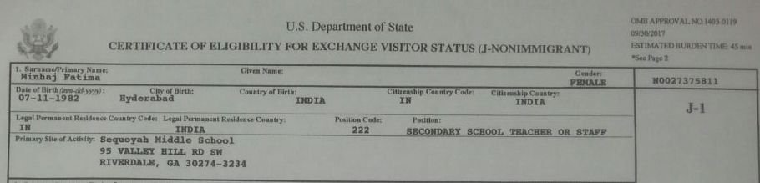
FORM DS-2019

Slide 5
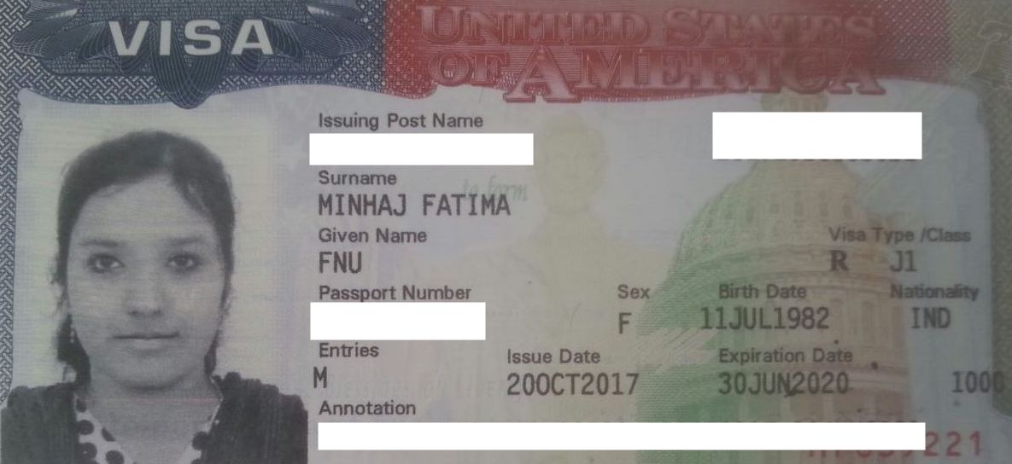
USA VISA

Slide 6
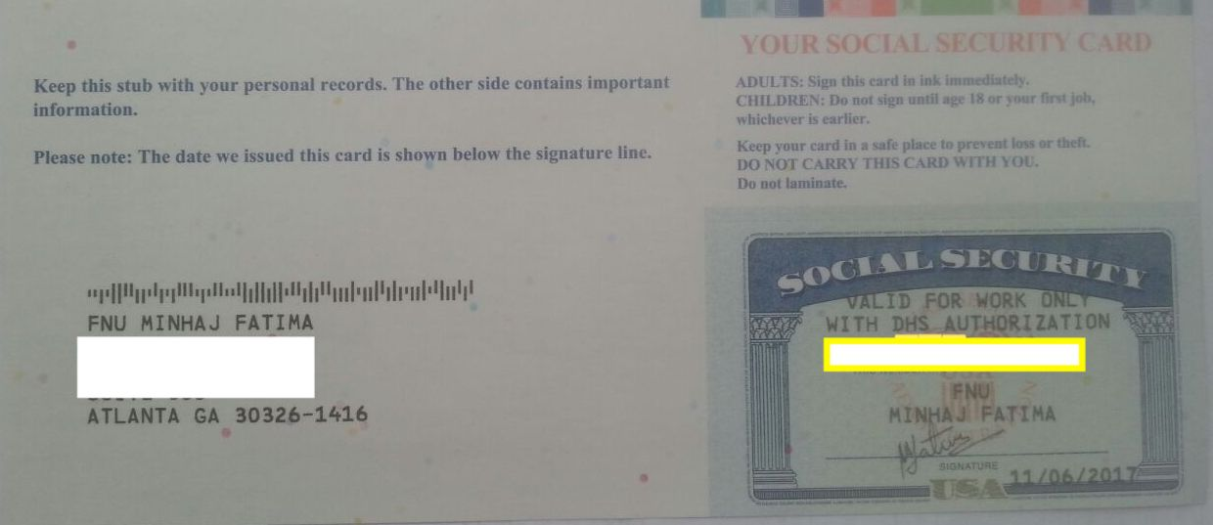
Social Security Card

Slide 7
HOW TO AVOID “FNU” ???
FNU : First Name Unknown
Have to have – Last name OR Surname for official documents in USA
If you don’t then your first name is used as Last name (Minhaj Fatima)
Please follow the simple steps outlined in the next few slides

Slide 8
Documents required:
Printed application
Appointment confirmation page
A Cover page requesting Regional Passport Officer to reissue passport with name bifurcated into first and last name in the form of a well written and easily understood letter.
Supporting documents:
Aadhar card
Old passport

Slide 9
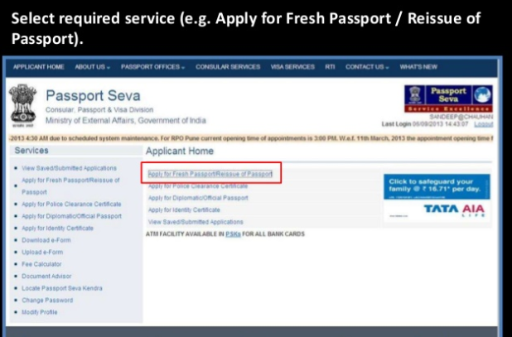

Slide 10
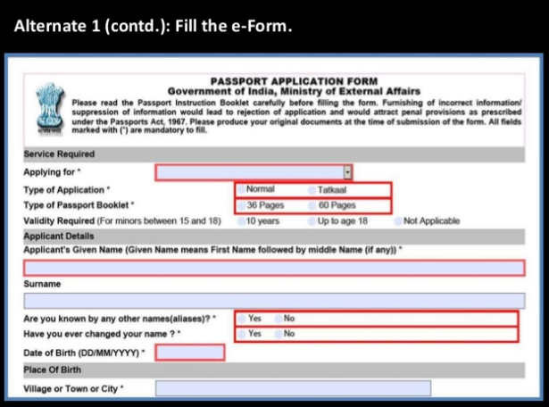
You can apply for reissue passport by filling application form online and writing your first name in given name and last name in surname
In “Applying for” select reissue of passport.

Slide 11
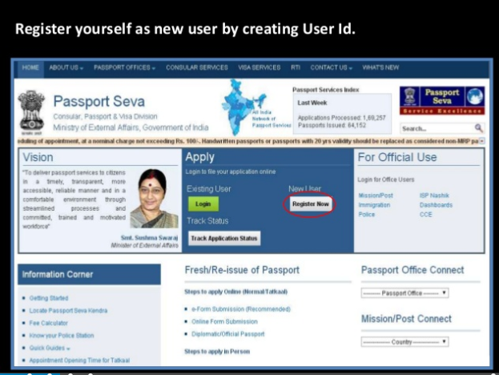

Slide 12
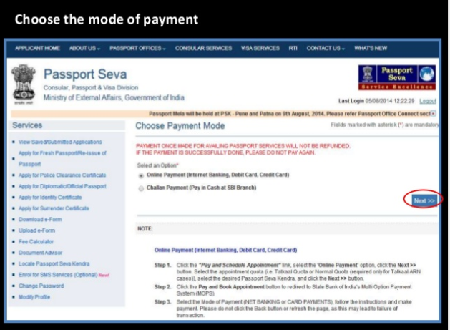
Complete the application and pay the required fee

Slide 13
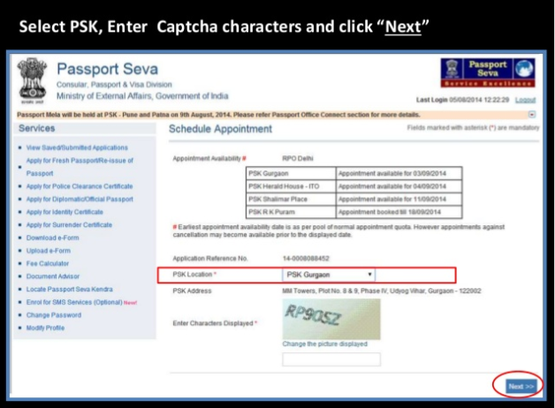

Slide 14
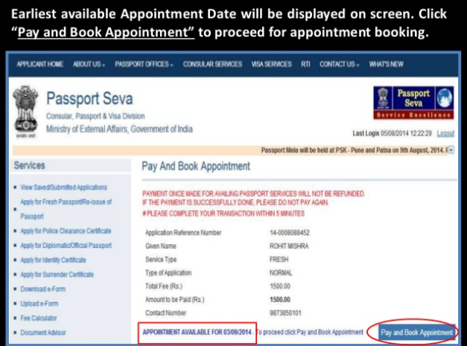

Slide 15
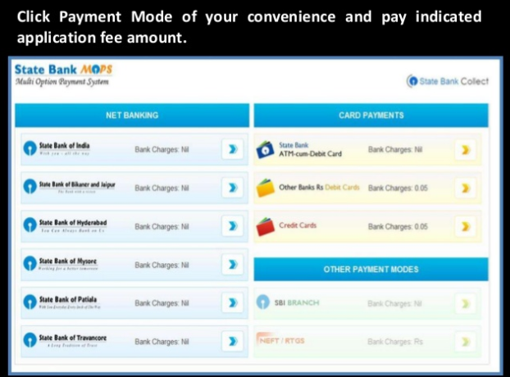

Slide 16
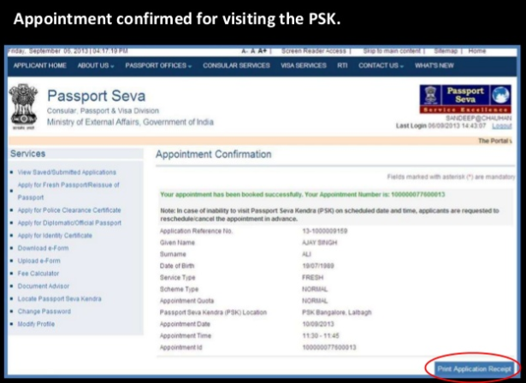

Slide 17
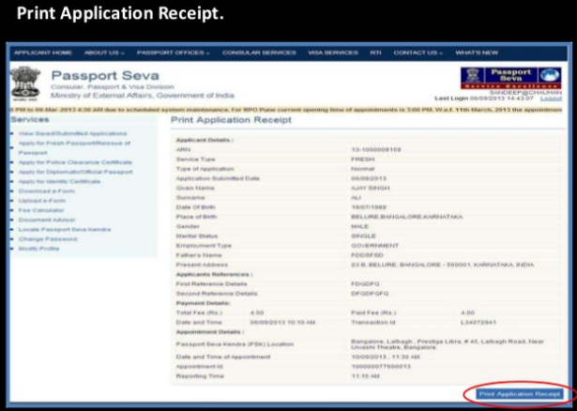

Slide 18
After the interview is complete, the police inquiry takes up to 2-3 days.
You passport will be delivered to you in up to 10 working days.

